Slide 1

Department of Computer science
Global institute of technology and management
Approved by AICTE, Gov’t. Of India & Affiliated to M.D. University, Rohtak
5kM Milestone , Khea Khurrampur Farruknagar, Hailymandi Road Gurugram -122506, Haryana, India
A project on Job Portal
Submitted By :-
Hiti Taneja
Harshit Verma
Head of Department
Aurko Bagchi

Slide 2
Present System
To conduct an interview is a tedious task as it requires planning and managing resources.
Selected candidates has to travel to that place and attend the conducted exam.
Difficult to provide resources to all the candidates.
Decrease the productivity of the company.
Doing such tasks on regular interval time , money and human power is wasted.
In certain situations, whole process is conducted but no output is gained. Hence, the employer as well as students gets demotivated.

Slide 3
Proposed System
To computerize the users profile and conduct online interviews.
Save time and work involved for employing people to the jobs posted.
For this a separate section named placement cell is maintained by the company which involves in selecting the right person for the right job.
Online test can be conducted for multiple users at a time and all the users will able to get the results within no time.

Slide 4
Project based on
Development and Database
Jsp
Servlet
Oracle
jQuery
Front End Development
HTML 5
CSS
Bootstrap

Slide 5
Objective of the Application
Use of less resources (time, labor money)
Selections can be done from any branch of the company.
Supports multiple users.
Helps in selecting skilled and professionally needed persons for the job in less time
Transparency in conducting online test.

Slide 6
System requirements
To run the project, certain hardware and software has to be installed on the system. The system requirements include:-
Microsoft Windows 8 workstation.
Internet Connectivity – min 2Mbps
A hard disk with a minimum of 500 GB
2 GB RAM.
A mouse or other suitable pointing device.

Slide 7
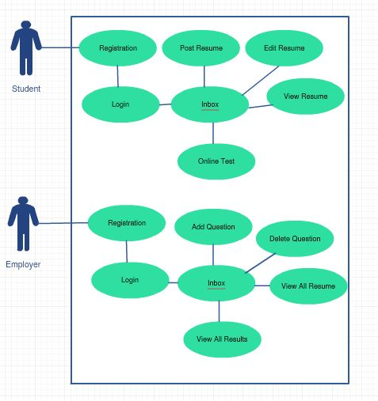
Use Case Diagram

Slide 8
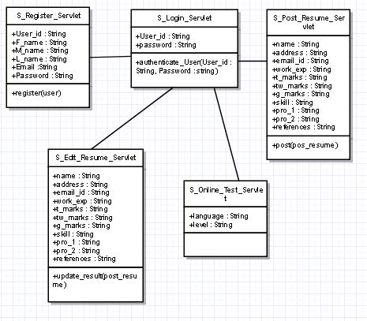
Class Diagram (User)

Slide 9
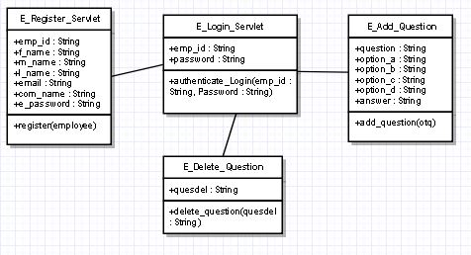
Class Diagram (Employer)

Slide 10
Future Scope of Application
Conduct conferences with their job seekers online.
Communicate business requirements of the company and have up-to-date information.
By seeing the job requirement only person having required skills will post their resumes so no need of short listing.

Slide 11
OUTPUT SCREENS

Slide 12
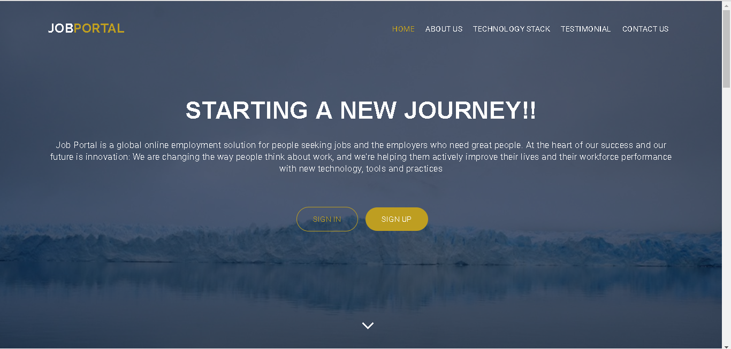
HOME PAGE

Slide 13
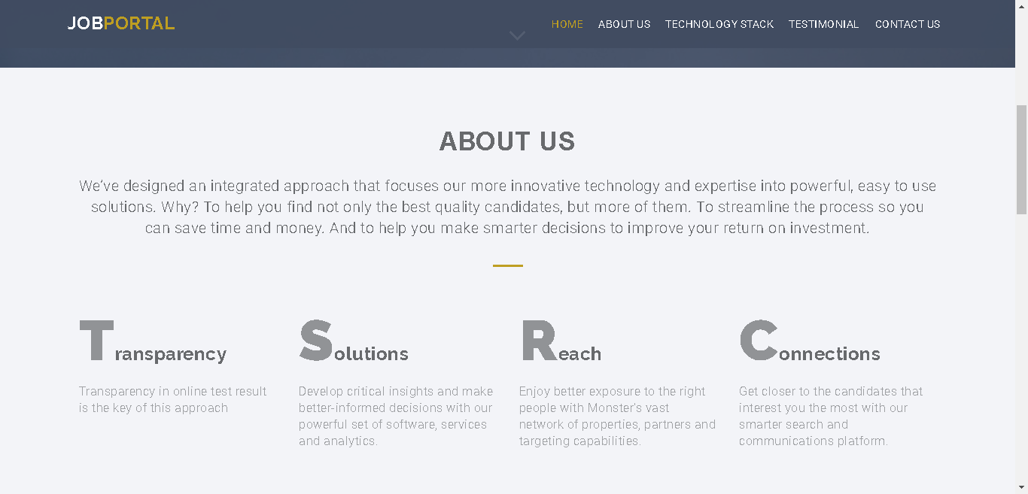
HOME PAGE(Contd.)

Slide 14
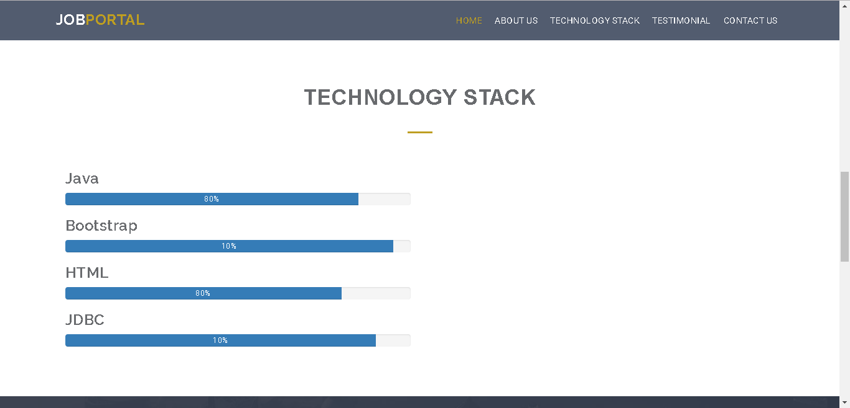
HOME PAGE(Contd.)

Slide 15
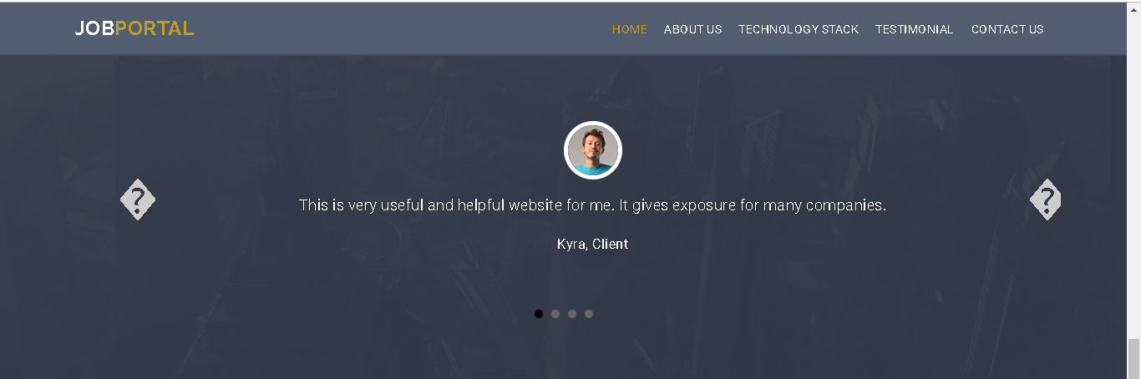
HOME PAGE(Contd.)

Slide 16
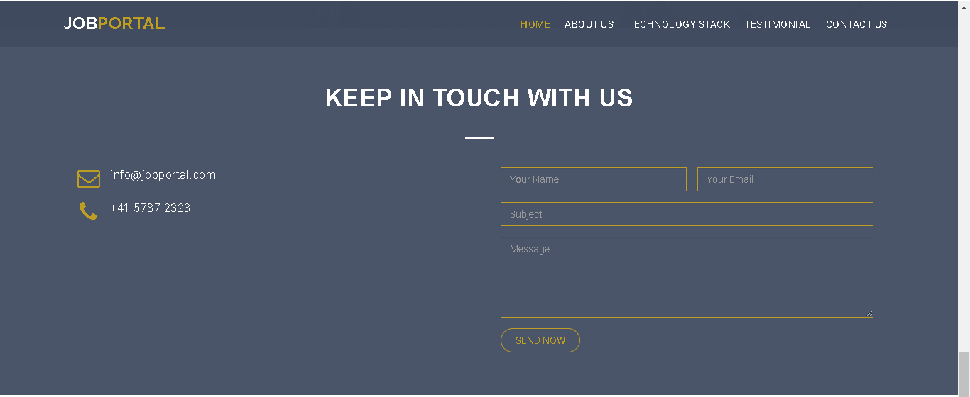
HOME PAGE(Contd.)

Slide 17
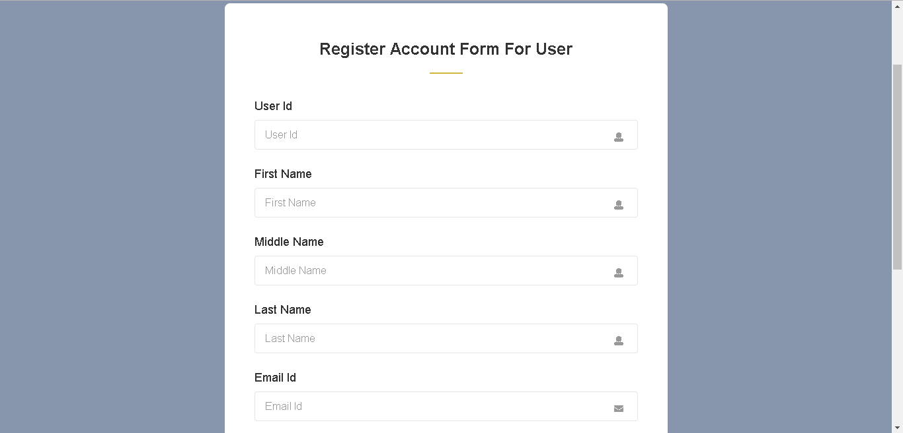
CANDIDATE REGISTRATION PAGE

Slide 18
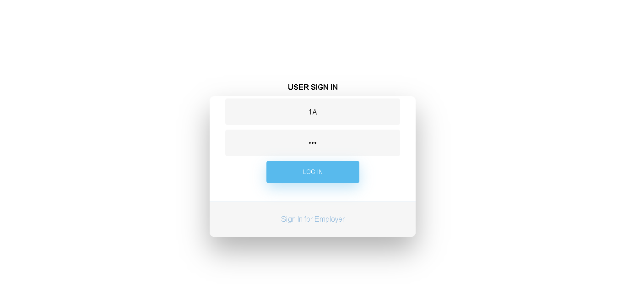
CANDIDATE LOGIN PAGE

Slide 19
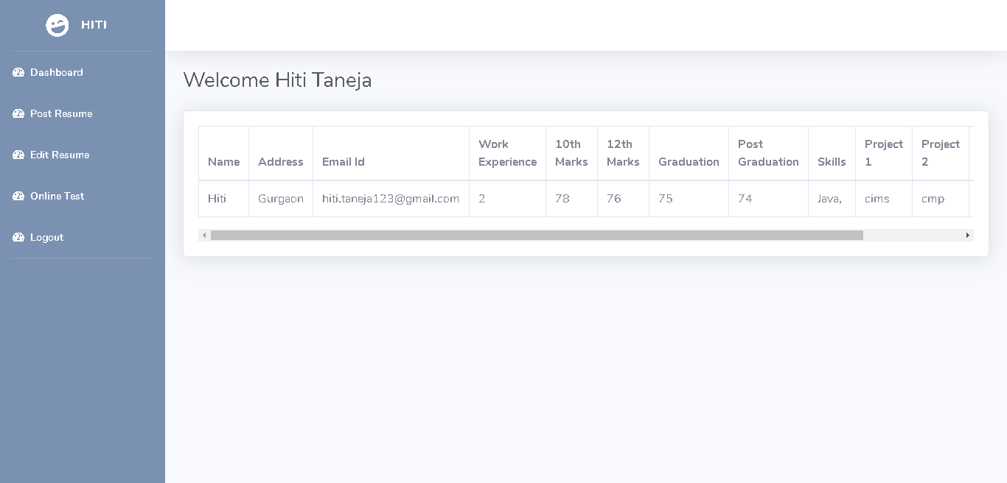
CANDIDATE DASHBOARD PAGE

Slide 20
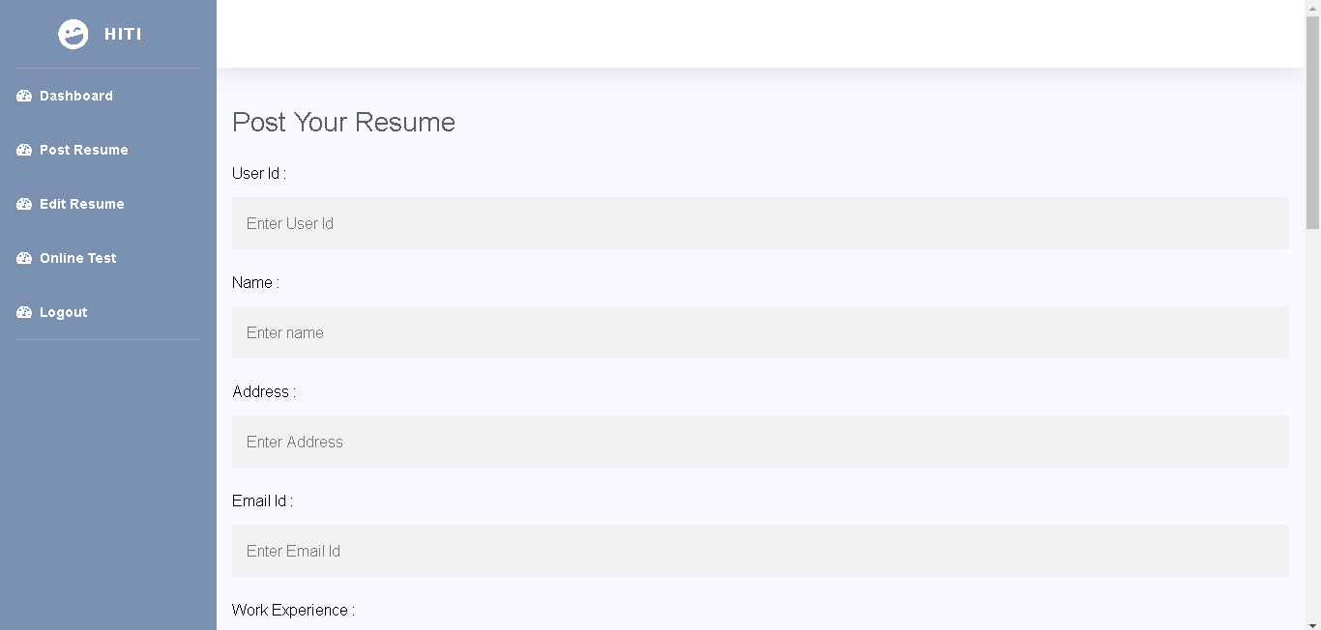
POST RESUME PAGE

Slide 21
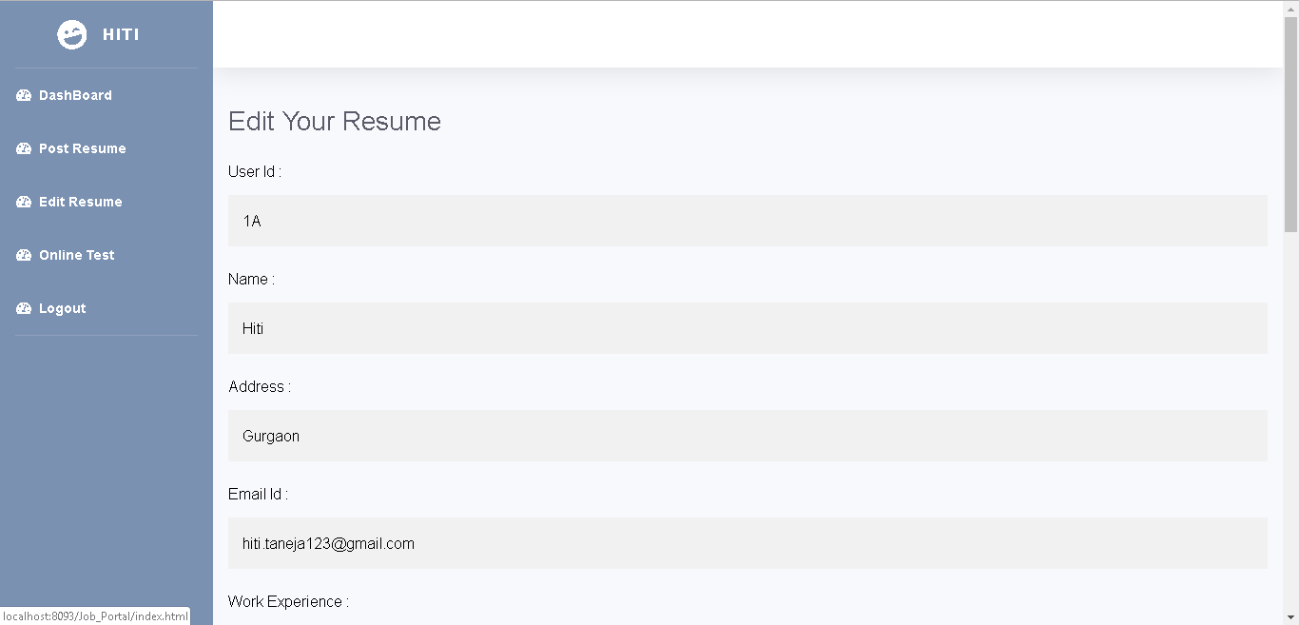
EDIT RESUME PAGE

Slide 22
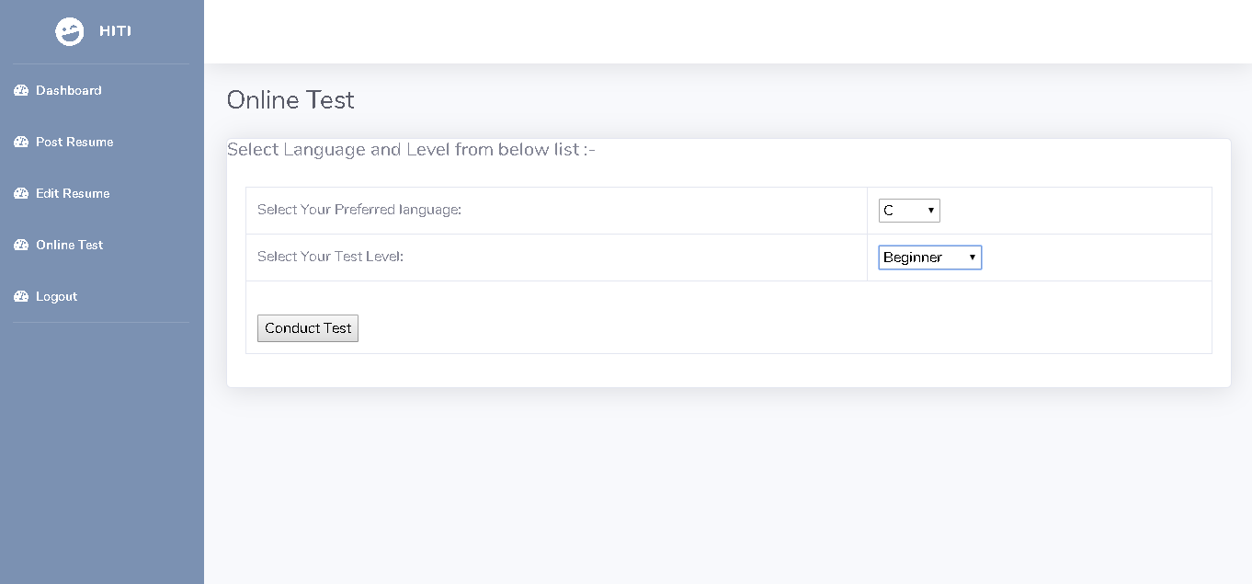
ONLINE TEST PAGE

Slide 23
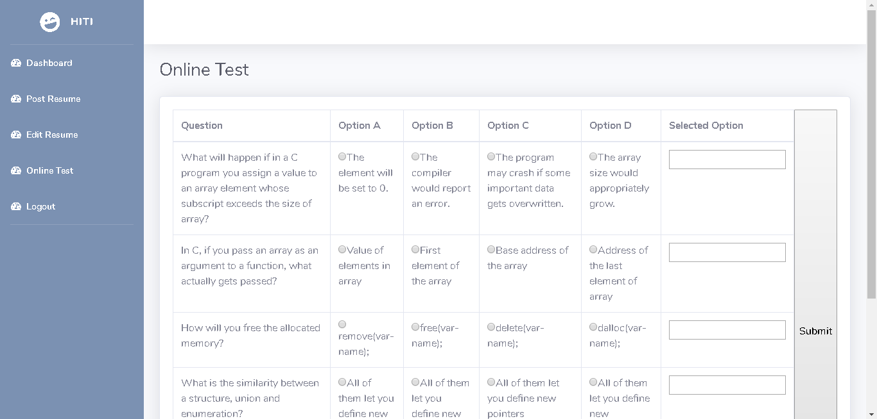
ONLINE TEST PAGE(Contd.)

Slide 24
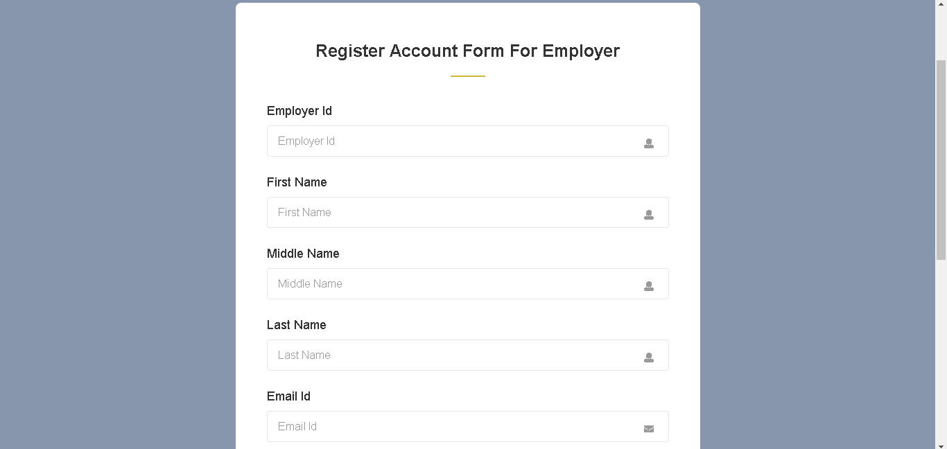
EMPLOYER REGISTERATION PAGE

Slide 25
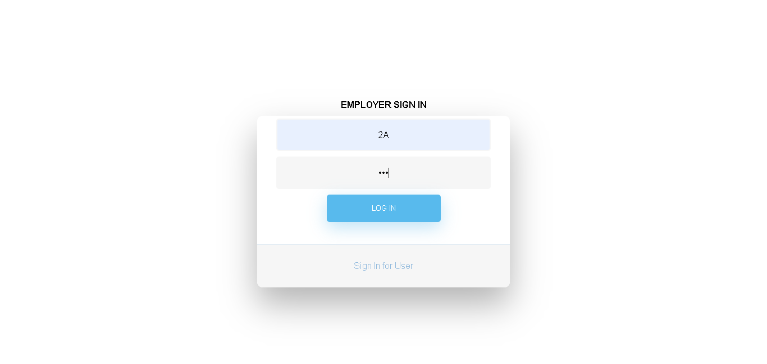
EMPLOYER LOGIN PAGE

Slide 26
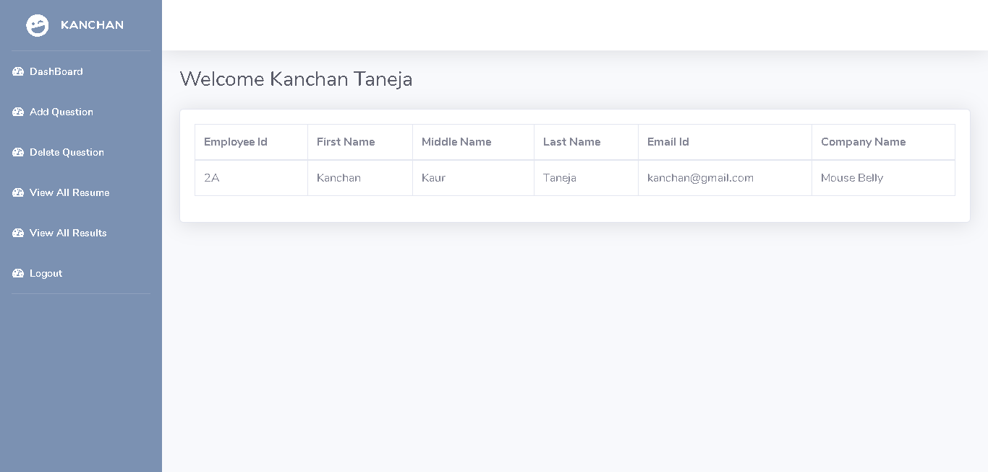
EMPLOYER DASHBOARD PAGE

Slide 27
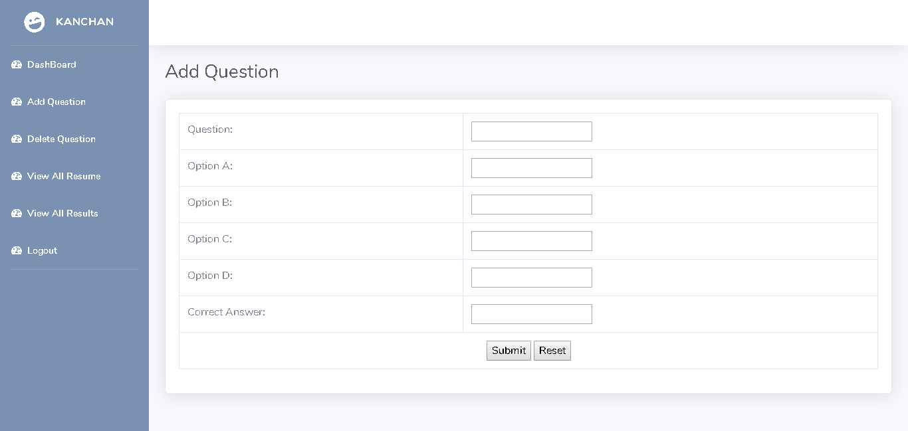
ADD QUESTION PAGE

Slide 28
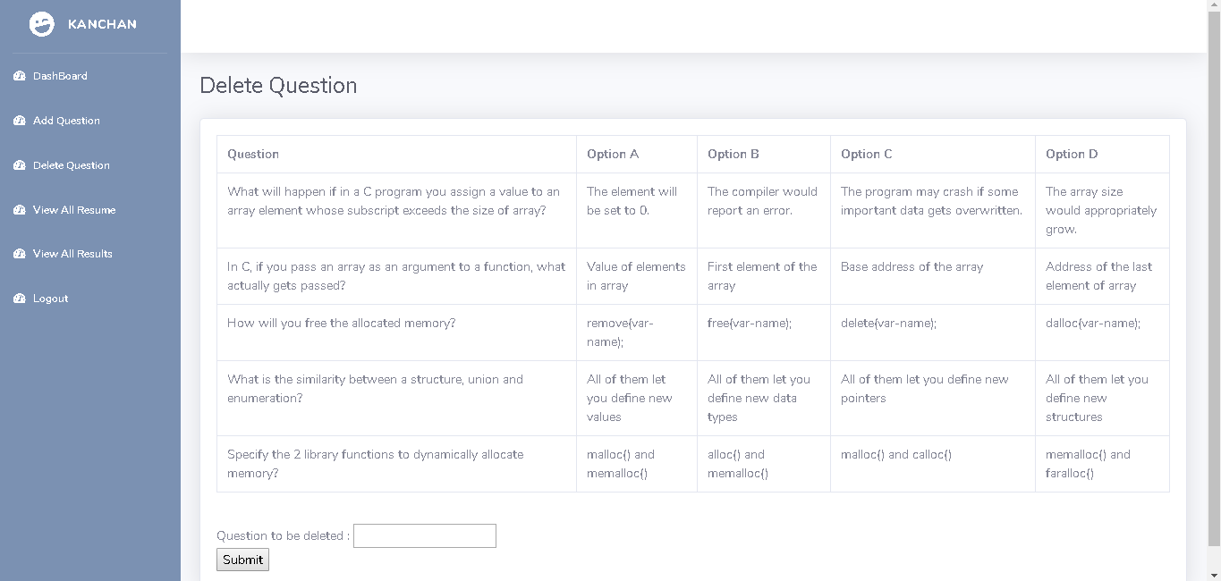
DELETE QUESTION PAGE

Slide 29
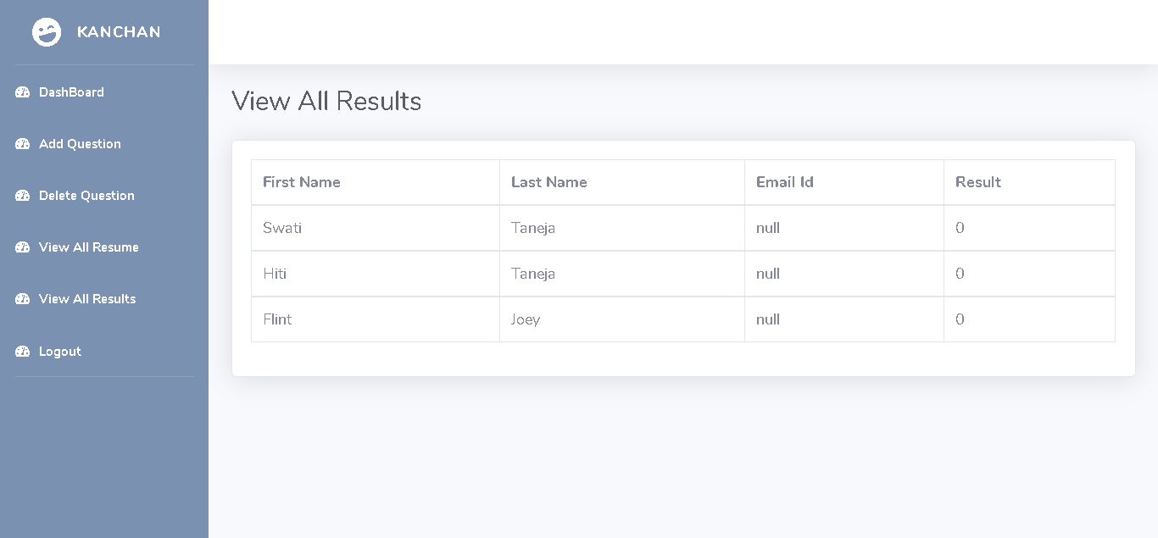
VIEW ALL RESULT PAGE

Slide 30
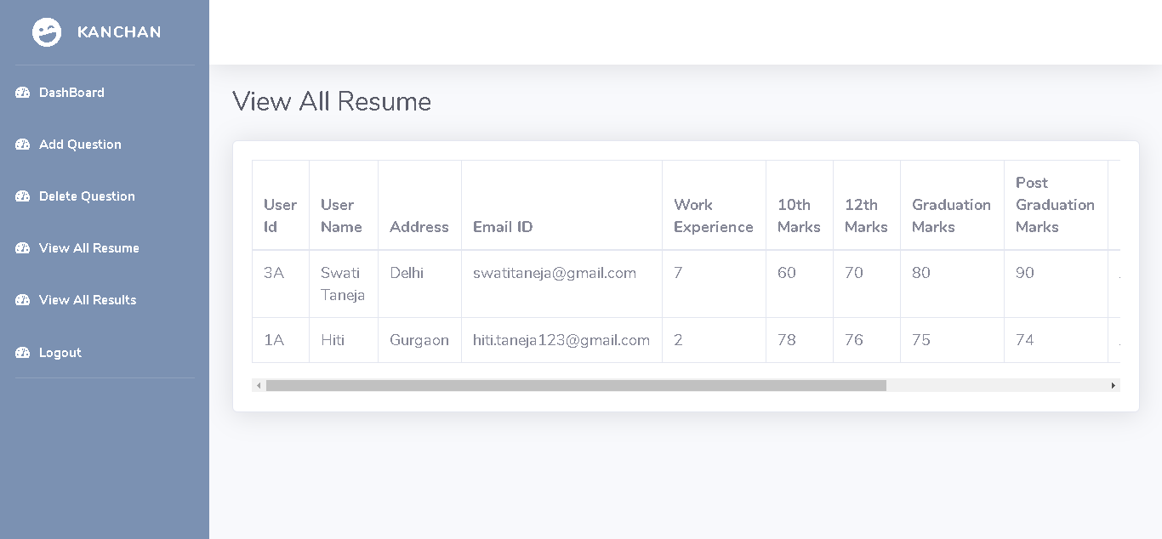
VIEW ALL RESUME PAGE

Slide 31
Thank you

